Slide 1
Structured Query Language
SQL
An Introduction to Organizing and Retrieving Data
with SQL

Slide 2
Let’s Look At What SQL Is
SQL is a specially designed programming language for managing data held in a relational database management system (RDBMS)
SQL consists of:
a data definition language – allows users to create objects
a data manipulation language – allows users to update
objects
a data control language
ALL IN ONE EASY TO USE language

Slide 3
Standardized Tool for Data
The SQL language is a standard relational database management system codified in the following standards:
ANSI (American National Standards Institute)
International Standards Institure (ISO)
ANSI SQL first released in 1986 for ANSI and 1987 for ISO
The language is standardized, save the trend for manufacturers to privately enhance their versions
This affects “portability” to a small or great extent

Slide 4
SQL History
Originally designed started by IBM from a paper “SEQUEL (Structured English QUEry Language)”
SEQUEL (Structured English QUEry Language) later changed to SQL to remove the legal threat from Hawker-Sidley, an English corporation that held the copyright on SEQUEL
The name is pronounced “SEE-Quel”
The most common object in SQL is the query
The SQL language is embedded in queries and procedures

Slide 5
Why Is ANSI Standard Important
Since all major relational databases support the minimal ANSI standard query language :: they can all “talk” together
A standard interface called ODBC (Open DataBase Connectivity) is the common link between them all
Many have what is known as “Native” mode connectivity
So, for all practical purposes, SQL allows alien (disparate) databases to share data across virtually all tables that DBA’s give access to

Slide 6
ANSI and Interoperability
Even though we claim a large language interoperability through ANSI, the size of the specification is very large so, in some areas, this leads to ambiguous implementation
At this time manufacturers self-certify their compliance with the ANSI standard
In addition, manufacturers add small special language enhancements that make their product unique
This ensures a constant flow of licensing revenue
This also ensures a competitive pressure to meet customer needs
It also means Interoperability is affected to some degree

Slide 7
What Databases are ANSI
The list is long (and it is intended to be):
Microsoft Access
IBM DB2
IBM Informix
Oracle
MySQL
Microsoft SQL Server
Sybase
SAP
Teradata

Slide 8
So Where Do You Fit In
Leaning SQL is one of the best resume entries you can have
Virtually ALL businesses that employ data analysts REQUIRE some understanding of SQL
It is businesses most used analytical tool
Corporations and govt offices expect its analysts to be proficient in SQL
Some of you will self-educate; some will take on-line courses
Some of you will take Boot Camps
Which ever way you do it…..DO IT

Slide 9
How We Will Proceed
SQL is, at least in the beginning, a straight forward process
We will begin the seminar with an easy set of SQL statements : the Single Table Query and some functions
We will then work our way into more complex statements, including JOINS (the linking of tables through common keys)
We will then play with some SQL aggregate functions
We will NOT move into SQL statements that are complex and which require upfront training on overall database design

Slide 10
Three Basic Terms Used in Databases
Field (sometimes called a Column)
  The basic unit of database tables
  Holds one piece of data—first name, last name, street
Record (sometimes called a Row)
  A collection of all fields related to one item
  All fields for a person or company
File (sometimes called a Table)
  A collection of all related records stored together
  All customers or all suppliers

Slide 11
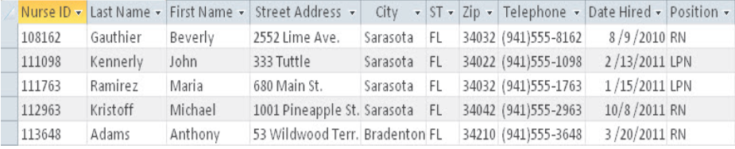
Some Important Terminology
Columns or Fields
Rows or Records
Table

Slide 12
The Database Hierarchy
All RDBMS (Relational Database Management Systems) maintain the same object Hierarchy
Database
Tables
Records
Fields
Tables are linked by keys to form “relationships”

Slide 13
Let’s Begin with a Short Review of Databases
A Sample Doctor’s Practice Patient Invoice
Unorganized Data
Limits speed of processing
Makes duplicate (redundant)
data difficult to control
Makes inconsistencies
difficult to contol
Taken from these database tables
Organized Data

Slide 14
DBA’s Organize Data Into Related Tables
In IT this is called “Divide and Conquer”
Unorganized Data is organized into related tables that contain related data
Data broken down into its smallest relatable values allows for very fast retrieval from database tables
It also allows analysts to select only fields of interest rather than include fields that are extraneous to their need
We also use “keys” to gain faster access to data and to JOIN tables back together using queries

Slide 15
From Organized Data Tables We Get….
Fast access to relevant data
Ability to JOIN other tables to reverse the divide and conquer imperative
In essence, we get our unorganized data back again in an infinitely more organized environment
This is done through:
organizing tables
writing queries against those tables

Slide 16
Why Do We Give This Seminar
So…let me see…
We organize by “divide and conquer” to get to the smallest unit of organization (Fields in Tables)
Then we use queries to put it all back together in a faster and more organized manner
So we can get it all back to where it was when we began…
We want to teach you the QUERIES that allow the above!
ORGANIZED!

Slide 17
The Short and Long of It
We want to Teach you the language of SQL queries

Slide 18
How Do We Setup Our PC’s?
To conduct the SQL seminar, we have chosen a SQL editor called “SQLdbx”
Follow these steps to bring up the application:
Locate the “SQLdbxFiles.zip” file; right click and extract all files
The zip extraction will create a folder called: SQLdbxFiles
Open the folder and double click on “SQLdbx.exe”
This will present the following screen

Slide 19
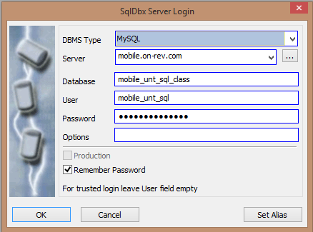
Opening the SQLdbx Editor
Click on “OK” when you get this screen

Slide 20
Logging Into Our Database Server
If the screen on the previous slide does not appear with the security fields populated:
Server : mobile.on-rev.com
Database : mobile_unt_sql_class
User : mobile_unt_sql
Password : bobUNT_sql1023
Click on OK
Case Sensitive

Slide 21
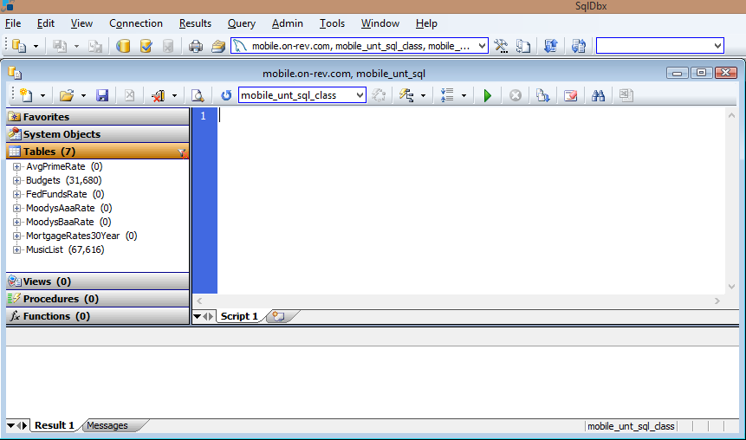
SQLdbx Editor

Slide 22
The Parts of a SQL Editor Screen
Command
Drop Down
Create and Execute Queries
The query or script pane
Objects
Pane
The Results Pane

Slide 23
The Core Components of a SQL Query
In the context of this seminar, a SQL statement is:
a set of core syntax that, when taken together, perform
a unique action on one or more databases or database
tables

Slide 24
The SQL SELECT Statement
The SQL SELECT statement is the most common statement used to extract data from a database; here is the statement format
SELECT *
FROM <Table Name>
WHERE <Condition>
ORDER BY <Ascending OR Desending>
To prepare for our first SQL statement, we will be working with the MusicList table
The Asterisk is a wild card representing “ALL”

Slide 25
What Is Intellisense
Intellisense is a feature in many database applications
In SQLdbx, Intellisense is implemented
Intellisense is a feature that:
a. Automatically monitors your typed entry
b. Suggests the next code, field or table so you can
Tab to accept Intellisense’s suggestion
c. Or simply continue on typing
You can easily see Intellisense suggesting code, field and table entries
We will stop and show you when Intellisense makes a suggestion

Slide 26
Our First SQL Query
In the script or query area, enter the following:
SELECT * FROM MusicList
OR
SELECT *
FROM MusicList
Click on the “Execute query” icon
Functionally Identical Entries

Slide 27
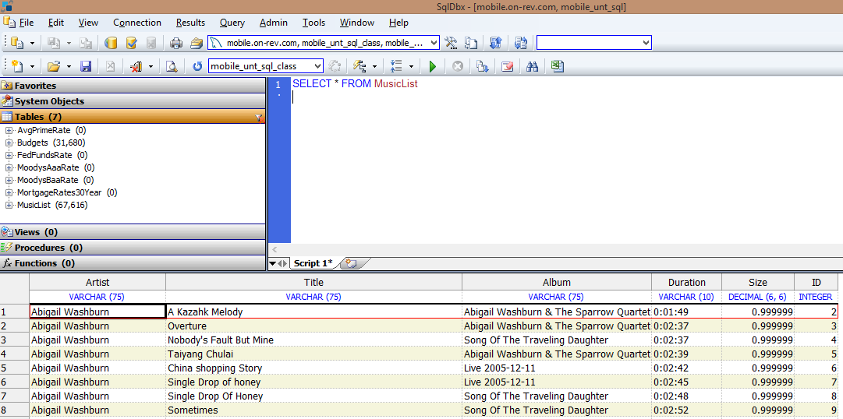
Results of First Query

Slide 28
Modify Our First Query
The Asterisk represents “All” fields in a table to be displayed
Let’s try this format, that exposes only the fields we want
SELECT Artist,
Album,
Title,
FROM MusicList
Click on the Execute icon
You will note that three fields are displayed
This vertical listing is the same as:
Notice the Vertical style entry

Slide 29
Another Alternative Entry
SQL is NOT case sensitive
select = SELECT
SELECT Artist, Album, Title
FROM MusicList
So, as you can see, there are a couple of ways to enter a SQL statement…either way the Results Pane displays the same output
There are also more advanced ways to enter complex queries that use Table synonyms…that is for later
Notice the Horizontal entry

Slide 30
Let’s Try Another Table
Enter the following query in either the Vertical or Horizontal format
SELECT * FROM Budgets
Click on the Execute query icon
And….
SELECT Division, Department, Category
FROM Bugdets
You get the idea…as long as fields are separated by commas it doesn’t matter how you enter them, vertical or horizontal

Slide 31
One Last Example to Reinforce Our Learning
We will now use the AvePrimeRate table and enter our same old query
SELECT * FROM AvePrimeRate
And…
SELECT Period, Rate FROM AvePrimeRate
We can summarize…”*” means ALL fields
Or if you want to see only specific fields, simply list the fields separated by commas either vertically or horizontally

Slide 32
Single Table SQL Queries
Break Time – 10 minutes

