Slide 1
Structured Query Language SQL Unit 2
An Introduction to Organizing and Retrieving Data with SQL

Slide 2
Some More Interesting Single Table Queries
In the last segment, we examined the history of SQL, a little bit about why we organize databases as we do and wrote our first SQL query with a single table
We want to continue creating single table SQL queries so we can move to more interesting SQL statements
Later we will design some really neat queries using SQL aggregate functions and multiple tables
But now, let’s play around with some more single table stuff

Slide 3
The WHERE Argument
Noting that our format for single table queries as: SELECT <Field Name1>, <Field Name2> (also “*”) FROM <Table Name> WHERE <Logic Flow> ORDER BY <Field Name (Column)> DESC
We want to examine the WHERE argument, which is optional
WHERE allows us to filter records by selecting values in a field
<Column>
<Column>
Don’t forget the commas

Slide 4
The Logical Operators
SQL uses the math operators to select records by field value
Operator | Meaning
> >= | Greater than, Greater than or equal to
< <= | Less than, Less than or equal to
<> | Not equal to
= | Equal to
And | Include multiple logical items
Or | Test for individual logic items
LIKE | LIKE s% - to find all fields (columns) starting with “s”

Slide 5
An Example for WHERE
Let’s try this example for WHERE:
For a paper, you need to find all months were the Federal Funds Rate was less than zero; using the FedFundsRate table SELECT Period,Rate
FROM FedFundsRate
WHERE rate < 1.0
Click on the Execute icon when you have completed the entry

Slide 6
Here is the Recordset from WHERE

Slide 7
The IN Operator with WHERE
The “IN” operator allows SQL to list all of the items a WHERE keyword will include in a filter SELECT division,department, category,item, year,Budget,actual,variance
FROM Budgets
WHERE item IN('training','telephone','Maintenance')
Also, NOT IN gives results of all fields that are NOT in the list

Slide 8
IN Operator Results

Slide 9
Another Example for WHERE
Let’s try another example for WHERE
Assume you have a need to find out how many months had a Federal Funds Rate of 5.55 SELECT Period, Rate
FROM FedFundsRate
WHERE Rate = 5.55
Click on the Execute icon when you have completed the entry

Slide 10
Another Recordset Using WHERE

Slide 11
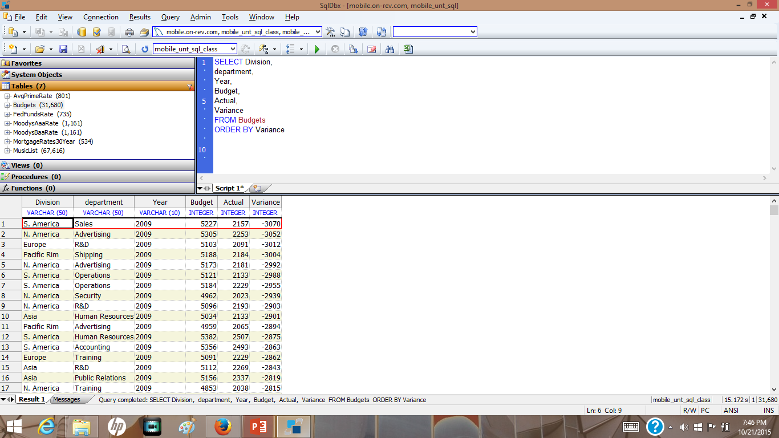
The ORDER BY Clause
In many cases, it is necessary to ensure that our data is sorted
Let’s look at a common SELECT statement that includes an ORDER BY clause SELECT <Field Name1>, <Field Name2> (also “*”) FROM <Table Name> WHERE <Logic Flow> ORDER BY <Field Name (Column)> DESC
If the DESC (for Descending) is omitted, the Ascending sort is assumed
DESC is for Descending

Slide 12
Wild Card Characters with LIKE
The LIKE keyword is a powerful tool to select records with a particular pattern
SQL uses “wild cards” to support this function
Wild Card Character | Meaning
% | A substitute for zero or more characters
_ (underscore) | A substitute for one character
[Charcter List] | Sets and ranges of characters to match
[^ Character List] or [! Character List] | Matches only a character NOT specified within the brackets

Slide 13
Finding Records with LIKE
The LIKE operator is used to select records that has a field (or column) that matches a particular pattern SELECT division,department, category,item,
year,Budget,actual,variance
FROM Budgets
WHERE Department LIKE 'd%‘ WHERE Departments LIKE ‘%d%’
The % sign means ANY OTHER character

Slide 14
Results of LIKE Query

Slide 15
Using the AND & OR Operators with WHERE
It is too simplistic an approach to believe that your need to query databases would only have a single field (column) condition
It is much more likely that your testing will include multiple conditions
SQL includes the AND & OR operators to allow multiple logical conditions

Slide 16
Using the AND & OR Operators with WHERE
Your manager wants to see all large departments (sales > 3000) with a negative budget variance SELECT division,department, category,item, year,Budget,actual,variance
FROM Budgets
WHERE Budget > 3000 AND Variance <0 AND Category LIKE '%F%'

Slide 17
And/OR Logical Actions

Slide 18
Sorting Using ORDER BY
Your manager needs to have department budgets sorted by their variance from Budget vs Actual to see the worst first
SELECT Division, department, Year, Budget, Actual, Variance
FROM Budgets
ORDER BY Variance
Also modify the query to use the DESC sort

Slide 19
SELECT with ORDER BY
Notice Vertical format

Slide 20
SELECT with ORDER BY DESC

Slide 21
SELECT with DISTINCT
In a table, a column (field) may contain many duplicate values; and sometimes you only want to list the different (distinct) values. SELECT DISTINCT Division FROM Budgets
ORDER BY Division

Slide 22
SELECT with DISTINCT
Five (5) Divisions

Slide 23
Using an ALIAS
An Alias is a method to override a field or column name with one of your own choice SELECT Division, department, Year, Budget, Actual, Variance AS Difference
FROM Budgets
ORDER BY Variance
AS creates a different column Name

Slide 24
SQL BETWEEN Operator
Allows the query to SELECT records or (rows) that are between a range of values SELECT Division, Department, Category, Item, Variance
FROM Budgets
WHERE Variance BETWEEN 2000 AND 3000

Slide 25
BETWEEN Example

Slide 26
Some Very Simple Functions
SQL has many functions that assist data and financial analysts to be as finite as possible with data
Function | Purpose
Count(<Fieldname>) | The COUNT(column_name) function returns the number of values (NULL values will not be counted) of the specified column
Count(*) | Counts the number of records in a Table
Avg() | The AVG() function returns the average value of a numeric column
SUM() | The SUM() function returns the total sum of a numeric column.
MAX() | The MAX() function returns the largest value of the selected column.
ROUND(Column, Decimals) | The ROUND() function is used to round a numeric field to the number of decimals specified.
Now() | Returns the current date and time

Slide 27
SQL Counting
One of the functions of a SQL query is to count the records in a recordset or table
SELECT COUNT(*) FROM Budgets SELECT COUNT(*) FROM MusicList
SELECT COUNT(*) FROM AvePrimeRate

Slide 28
COUNT Results Using LIKE

Slide 29
COUNT Results Using LIKE

Slide 30
Using Multiple Functions
Your manager wants to know the sum of all budgets for the corporation SELECT sum(budget), avg(budget), max(budget),min(budget), stddev(budget)
FROM Budgets

Slide 31
Multiple Functions with WHERE
WHERE with logic

Slide 32
More Multiple Functions
Your manager now wants you to calculate the values for only the Data Processing and Human Resources departments SELECT sum(budget), avg(budget), max(budget),min(budget),count(budget), stddev(Budget) ‘Population STDev
FROM Budgets
WHERE Department IN('human resources','data processing')

Slide 33
Multiple Functions with WHERE and IN
IN function

Slide 34
Unit 2 Summary
We have examined some query examples, staying away from one of the more powerful functions in SQL
Single table queries are straightforward
SQL queries using multiple tables are still straightforward, but just a bit more interesting
We call these queries JOIN queries
We will review these after a break

