Slide 1
Structured Query Language SQL Unit 3
An Introduction to Organizing and Retrieving Data with SQL

Slide 2
Queries with Multiple Tables
In the last segment, we concentrated on the many variations of a single table query in SQL
You should have perceived that this is pretty neat stuff
We now move to examining what turns out to be a leap in both functionality and the analytical power of SQL
We now begin our trek into the SQL JOIN
We will show how more than one table can “Talk” to each other through what is known as JOIN

Slide 3
What Is a SQL JOIN
A “JOIN” is a method of having two or more tables share related data
The sole purpose of a database is to organize data so that data can be used in an efficient manner
Earlier we said that “divide and conquer” is the mantra of database technology
But once we have sliced and diced the data into related tables, how do we put it all back together
The answer is the SQL JOIN

Slide 4
What Is Needed to JOIN Tables
When tables are created in a database, primary and foreign keys are created so tables can be linked together
So in order to JOIN tables together, we need two (2) keys, one from each table to be JOIN’ed SELECT FedFundsRate.Period, FedFundsRate.Rate,MortgageRates30Year.Rate
FROM FedFundsRate
JOIN MortgageRates30Year
ON FedFundsRate.Period=MortgageRates30Year.Period

Slide 5
An Example of a JOIN
The government keeps extensive records on all parts of our financial system
In this example we will JOIN tables of different financial information from multiple tabes
SELECT FedFundsRate.Period,FedFundsRate.Rate AS "Fed Fund Rate",MortgageRates30Year.Rate AS "30 Year Mort Rate"
FROM FedFundsRate
JOIN MortgageRates30Year
ON FedFundsRate.Period=MortgageRates30Year.Period

Slide 6
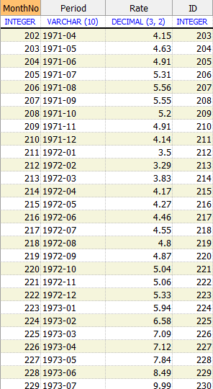
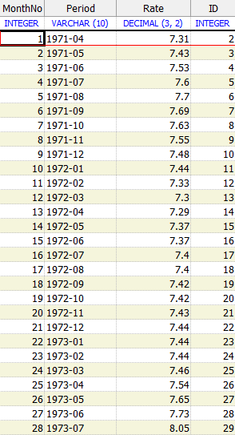
Two Sample Tables
Fed Funds Rate Table
30 Year Mort Rate Table
We Join tables using keys

Slide 7
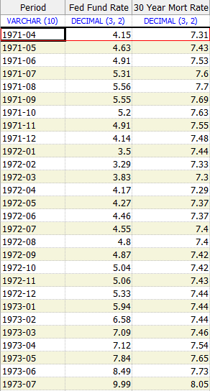
One JOIN’ed Table with Both Table Values
Both columns exist in 1 table

Slide 8
Invoice and Detail Data JOIN
SELECT Customer,
OrderDate,
ShipName,
Product,
UnitPrice,
Quantity,
unitprice*quantity AS Total
FROM Orders
JOIN OrderDetails
ON Orders.OrderID=OrderDetails.OrderID
WHERE OrderDate BETWEEN '1994/5/1' AND '1995/5/1'
Two keys are equal

Slide 9
GROUP BY
Aggregate functions perform a calculation on a set of values and return a single value. Except for COUNT, aggregate functions ignore null values. Aggregate functions are frequently used with the GROUP BY clause of the SELECT statement.
Some Aggregate functions are: a. Count() d. Min() b. Sum() e. Max() c. Avg()

Slide 10
GROUP BY
Group By is used to perform grouped operations on a column
For example a manager wants to know what the budgets were for each division of the company
SELECT division, FROM Budgets
GROUP BY Division
SELECT department, sum(Budget), sum(Actual),
FROM Budgets
GROUP BY Department

Slide 11
GROUP BY Example
Your manager wants to know how many Products we buy from a Supplier SELECT Supplier, Count(supplier)
FROM Products
GROUP BY Supplier

Slide 12
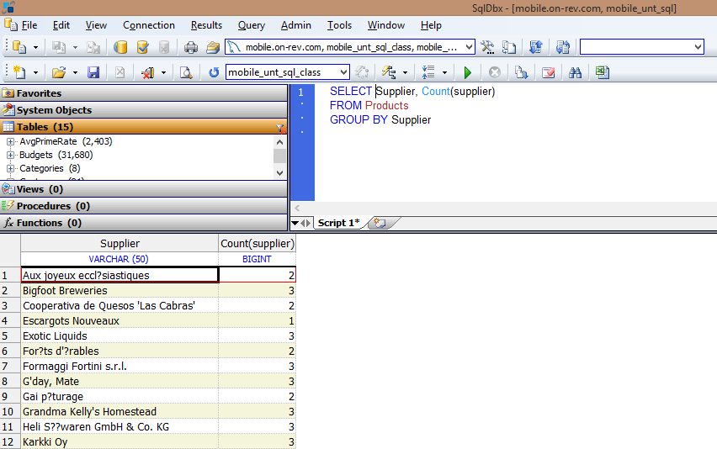
GROUP BY Example

Slide 13
GROUP BY with HAVING
HAVING in SQL is the equivalent to the WHERE clause in the Group By SELECT statement

Slide 14
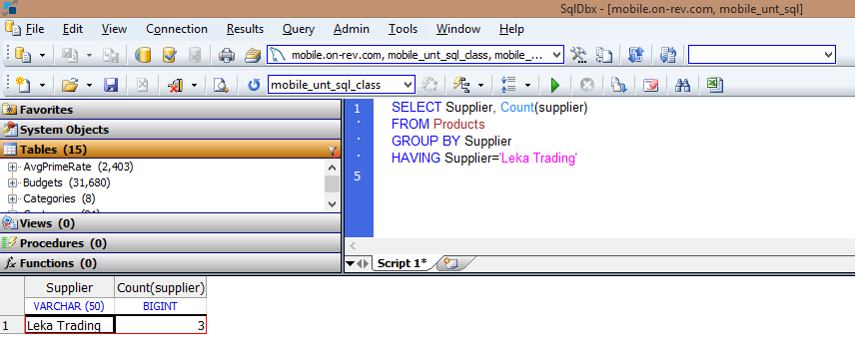
HAVING Example Output

Slide 15
Another GROUP BY HAVING Example
Your manager needs to prepare a special report using the following Suppliers: a. Leka Trading b. Exotic Liquids c. New Orleans Cajun Delights SELECT Supplier, Count(supplier) AS "Number of Products"
FROM Products
GROUP BY Supplier
HAVING Supplier IN('Leka Trading','Exotic Liquids','New Orleans Cajun Delights')

Slide 16
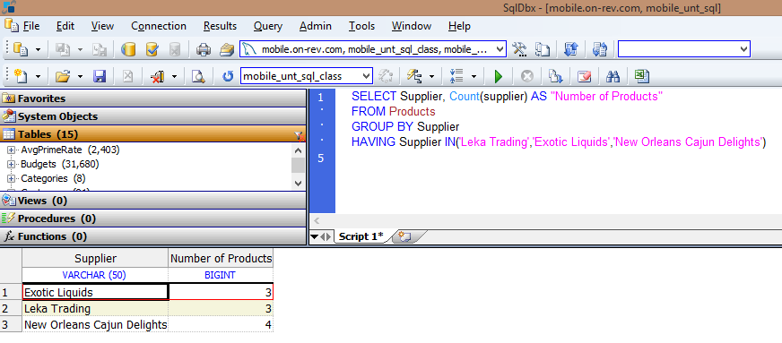
More GROUP HAVING Output
Notice IN is used as in WHERE

Slide 17
Using NULL
The NULL character is the first character of the ASCII code
All fields or column in a new record are set to NULL
It means the field or column is undefined
Testing for the NULL character is easy SELECT companyname,state
FROM Customers
WHERE state IS NULL (or IS NOT NULL)

Slide 18
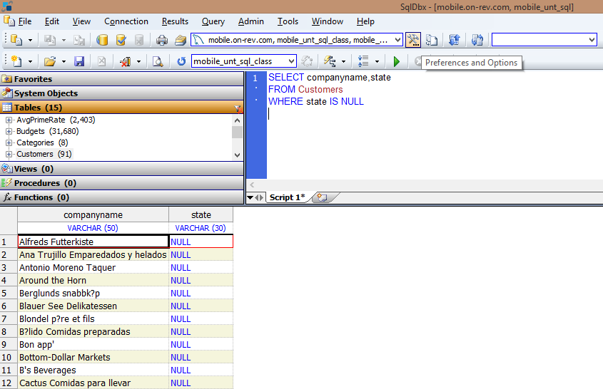
Sample IS NULL Output

Slide 19
JOINing More Than Two Tabes
We have previously JOINed two tables in Unit 2
We will now examine the SQL statement to JOIN more than two (2) tables SELECT FedFundsRate.Period
, FedFundsRate.Rate AS "Fed Funds Rate"
, AvgPrimeRate.Rate AS "Avg Prime Rate",MoodysAaaRate.Rate AS "Moodys Aaa Rate"
,MoodysBaaRate.Rate AS "Moodys Baa Rate"
FROM FedFundsRate
JOIN AvgPrimeRate ON AvgPrimeRate.Period=FedFundsRate.Period
JOIN MoodysAaaRate ON MoodysAaaRate.Period=FedFundsRate.Period
JOIN MoodysBaaRate ON MoodysBaaRate.Period=FedFundsRate.Period
WHERE FedFundsRate.Rate < 1.0
Notice use of AS to rename output fields

Slide 20
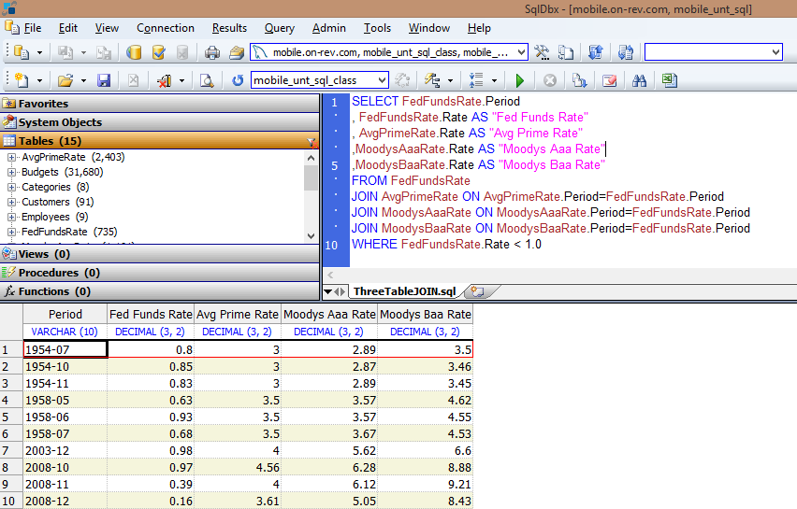
Output From Three Table JOIN

Slide 21
End of Our Training
In the past ½ day, we have gone over quite a few aspects of the SQL language
But simply playing with the language without giving ourselves a few problems to solve does not reinforce our learning
So we will be doing a few exercises just to make what we have reviewed stick around a bit longer

